Slide 1
Exception Handling in JAVA

Slide 2
Exception Handling
An exception is
A problem that arises during the execution of a program ( at run-time)
When an exception occurs
The normal flow of the program is interrupted and the program terminates abnormally
Therefore, these exceptions need to be handled
The Exception Handling in JAVA is
One of the powerful mechanism to handle the run-time errors
So that normal flow of the program can be maintained

Slide 3
Exception Handling
An exception can occur for many different reasons some of which are
A user has entered an invalid data
A file that needs to be opened cannot be found
A network connection has been lost in the middle of communications, etc.
Some of these exceptions are caused by
Error made by the user
Error made by the programmer
Failure of physical resources in some manner, etc.
Errors
Problems that arise which are beyond the control of the user or the programmer
Exceptions
Events that occur in the code and can be handled by the programmer

Slide 4
Exception Handling
Exceptions are of two types
Checked exceptions
Occur at the time of compilation
Also called as compile time exceptions
Cannot simply be ignored, Should be handled before execution
Unchecked exceptions
Occur at the time of execution (e.g., logical errors )
Also called as Runtime Exceptions
Ignored at the time of compilation
Error
Error is irrecoverable e.g. OutOfMemoryError,VirtualMachineError, etc.

Slide 5
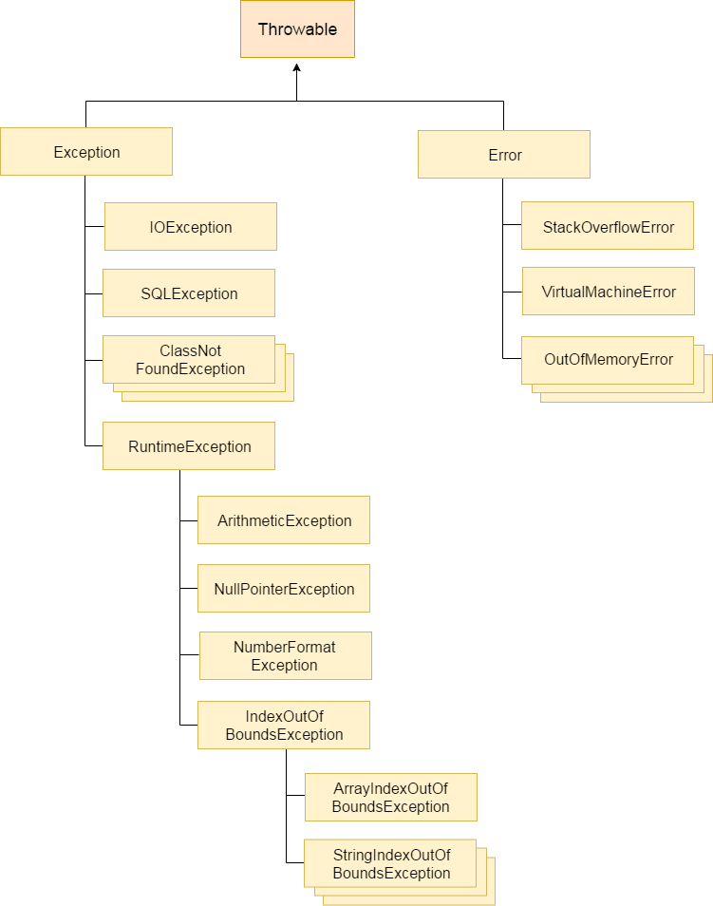
Hierarchy of Java Exception classes
The java.lang.Throwable
Root class or super class of
All errors and exceptions
Inherited by
Two sub-classes
Exception
Error

Slide 6
Common Scenarios of Exception
ArithmeticException occurs
If we try to divide any number by zero
Example
int a = 50 / 0;
NullPointerException occurs
If we have a null value in any variable, then performing any operation on the variable throws a NullPointerException
String s = null;
System.out.println(s.length());

Slide 7
Common Scenarios of Exception
NumberFormatException occurs
If the formatting of any variable or number is mismatched, it may result into NumberFormatException
Suppose we have a string variable that has characters, then converting this variable into digit will cause NumberFormatException
String s = "abc";
int I = Integer.parseInt(s);
ArrayIndexOutOfBoundsException occurs
When an array exceeds to it's size, the ArrayIndexOutOfBoundsException is thrown
int a[] = new int[5];
a[10] = 50;

Slide 8
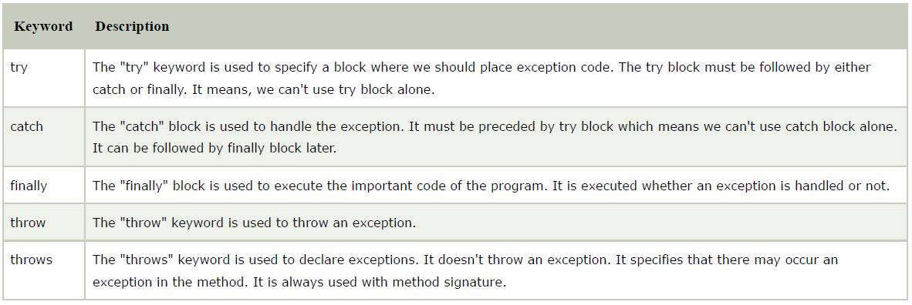
Examples of Handling Java Exception
To handle exceptions in Java
5 keywords are used

Slide 9
Example 1: Handling Exception
Without Handling Exception
public class Java_Exception_Example_1
{
public class Java_Exception_Example_1
{
public static void main(String args[])
{
int a = 20, b = 10, c;
c = a / b;
System.out.println("Value of c = " + c);
System.out.println(“Rest of the codes of the program..”);
}
}
}
Output:
Exception in thread "main" java.lang.ArithmeticException: / by zero
at Java_Exception_Example_1.main(Java_Exception_Example_1.java:7)

Slide 10
Examples of Handling Java Exception
With Handling Exception
public class Java_Exception_Example_1
{
public static void main(String args[])
{
int a = 20, b = 0, c;
try
{
c = a / b;
}
catch(Exception e)
{
System.out.println(“Exception :: ” + e);
}
System.out.println(“Rest of the codes of the program..”);
}
}
Output:
Exception :: java.lang.ArithmeticException: / by zero

Slide 11
Example 2: Handling Multiple Exception
public class Java_Exception_Example_2
{
public class Java_Exception_Example_2
{
public static void main(String args[])
{
int a[] = new int[5], b = 0, c;
try
{
System.out.println("a[10] " + a[10]);
c = a[2] / b;
}
catch(ArithmeticException e)
{
System.out.println("Exception :: " + e);
}
catch(ArrayIndexOutOfBoundsException e)
{
System.out.println("Exception :: " + e);
}
}
}
}
Output:
Exception :: Exception :: java.lang.ArrayIndexOutOfBoundsException: 10

Slide 12
Example 2: Handling Multiple Exception
public class Java_Exception_Example_2
{
public class Java_Exception_Example_2
{
public static void main(String args[])
{
int a[] = new int[5], b = 0, c;
try
{
System.out.println("a[10] " + a[10]);
c = a[2] / b;
}
catch(ArithmeticException | ArrayIndexOutOfBoundsException e)
{
System.out.println("Exception :: " + e);
}
}
}
}
Output:
Exception :: Exception :: java.lang.ArrayIndexOutOfBoundsException: 10

Slide 13
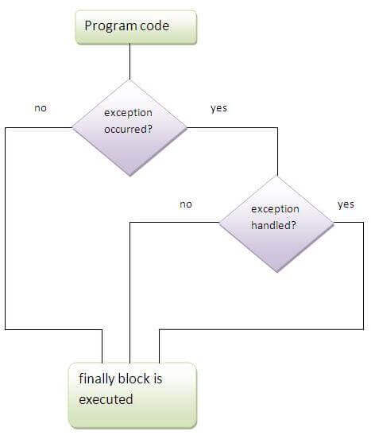
Example 3: Finally Block
The finally block follows a try block or a catch block
Always executes, irrespective of occurrence of an Exception
Using a finally block allows
To run any cleanup-type statements that you want to execute
No matter what happens in the protected code

Slide 14
Example 3: Finally Block
public class Java_Exception_Example_3
{
public class Java_Exception_Example_3
{
public static void main(String args[])
{
int a = 5, b = 0, c;
try
{
c = a / b;
}
catch(Exception e)
{
System.out.println("Exception :: " + e);
}
finally
{
System.out.println("finally block is always executed");
}
System.out.println("rest of the code...");
}
}
}
Output:

Slide 15
Example 4: Throw Keyword
Used to explicitly throw an exception from a method or any block of code
Mainly used to throw custom exceptions
public class Exception_Handling_Throw
{
public void validate(int age)
{
if(age<18)
throw new ArithmeticException("not valid");
else
System.out.println("welcome to vote");
}
public static void main(String args[])
{
Exception_Handling_Throw eht =new Exception_Handling_Throw();
eht.validate(13);
System.out.println("rest of the code...");
}
}
Output: Exception in thread "main" java.lang.ArithmeticException: not valid
at Exception_Handling_Throw.validate(Exception_Handling_Throw.java:6)
at Exception_Handling_Throw.main(Exception_Handling_Throw.java:14)

Slide 16
Example 4: Throws Keyword
The throws keyword
Indicates what exception type may be thrown by a method
Used for handling checked exceptions
Advantage
Can handle many methods at the same time
By declaring the exceptions in the method signature using throws
Handle the exceptions where you are calling this method by using
try-catch

Slide 17
Example 4: Throws Keyword
public class Exception_Handling_Throws
{
public int division() throws ArithmeticException
{
int a = 20, b = 0, c;
return (a / b);
}
public static void main(String args[])
{
Exception_Handling_Throws ehts = new Exception_Handling_Throws();
try
{
System.out.println(“Result = " + ehts.division());
}
catch(Exception e)
{
System.out.println("Exception :: " + e);
}
finally
{
System.out.println("Rest of the codes of the program");
}
}
}
Output :: Exception :: java.lang.ArithmeticException: / by zero
Rest of the codes of the program

Slide 18
Example 5: User defined Exceptions
class InvalidAgeException extends Exception {
InvalidAgeException() {
System.out.println("Not eligible to vote");
}
}
class User_defined_Exception {
static void validate(int age) throws InvalidAgeException {
if(age < 18)
throw new InvalidAgeException();
else
System.out.println("welcome to vote");
}
public static void main(String args[]) {
try
{
validate(12);
}
catch(Exception m) {
System.out.println("Exception occured: "+m);
}
System.out.println("rest of the code...");
}
}
Output :: Not eligible to vote
Exception occured: InvalidAgeException
Rest of the codes of the program...

